Slide 1
Analysis of Functional Modules in SAP&Oracle Apps
- Rishi Reddy
Pradeep Thomas
Department of Computer Science
Dr. C. C. Chan

Slide 2
Problem Statement
As per Forbes 2013 ERP Market share, SAP is having more market share when compared to Oracle Apps but SAP might not be the best solution for most of the cases.
In this context we would like to compare SAP with Oracle Apps and analyze the pros and cons of these two.
We would like to consider few variables like Modular implementation, Software Upgrades and Customer satisfaction.

Slide 3
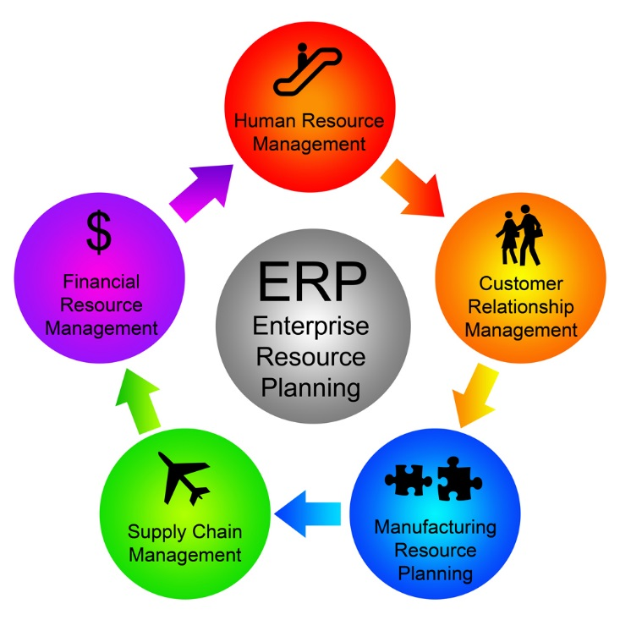
Introduction
What is Enterprise Resource Planning?
Notes:
Enterprise resource planning (ERP) is a cross-functional enterprise system driven by an integrated suite of software modules that supports the basic internal business processes of a company. It gives a company an integrated real time view of its core business processes such as production, order processing, and inventory management, tied together by ERP applications software and a common database maintained by a database management system.

Slide 4
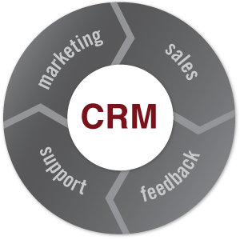
Introduction
What is Customer Relationship Management?
Notes:
Customer relationship management (CRM) is a model for managing a company’s interactions with current and future customers. It involves using technology to organize, automate, and synchronize sales, marketing, customer service, and technical support.

Slide 5
CRM in Oracle Applications
Oracle Channel Management
Oracle Marketing
Oracle Order Management
Oracle Sales
Oracle Service
Trade Management
Campaign management
Contracts and price management
Information about goods
Repairs & Returns Management
Service Contracts Management
Equipment and Installed Base Management
Marketing Control
Marketing Analysis

Slide 6
CRM in SAP
Marketing
Campaign Management
Trade Promotion Management
Sales
Services
Service Order Management
Segmentation
Order Management
Billing
Repairs & Returns Management
Service Contracts Management
Equipment and Installed Base Management
Notes:
Marketing : Marketing module helps the marketing department with customer acquisition. This includes one or more of the following activities
Campaign management – This includes different campaigns like e-mail, phone and other forms of customer engagement programs.
Trade Promotion Management -
Segmentation – Segmentation is the process of segregating your customers/leads/opportunities into different segments. This is used to effectively use the available time and resources on a targeted marketing plan.
Sales : Sales involves the OTC Cycle ( Order to Cash ) cycle excluding the logistics part. So this effectively includes
Order Management – This includes order management, contracts management, quotation management and other sales related activities.
Billing – This includes the billing of the orders created. Billing can either be done in ECC or in CRM. SAP CRM is specifically suited for Service related Billing.
Service : Service Module involves most activities that are involved in SAP ECC’s SM & PM Modules. They include
Service Order Management
Repairs & Returns Management
Service Contracts Management
Equipment and Installed Base Management

Slide 7
CRM in Salesforce
Marketing
Sales
Document Management
Service
Tracking Budget
Real Time Integration with third party tools
Current Contract Opportunities
Integrated content library for maintaining the Transaction History and price Details
Maintenance of Service History with the customers
Contracts
Campaign Calculations
Referring to Closed Deals to make new Deals
Clone and Customization of presentations given to customers

Slide 8
Differences in CRM
SAP | Oracle Apps | Salesforce
No Third Party integration | Third Party integration | Third Party integration
Call Center Management | No Call Center Management | Call Center Management
No customer support tracking | No customer support tracking | Customer support tracking
Can be Implemented on Cloud | Can be Implemented on Cloud | Only Implemented on Cloud
No Dashboards | Dashboards | Dashboards
Notes:
No third party integration .
Call center management like directly trying to call a customer over phone.

Slide 9
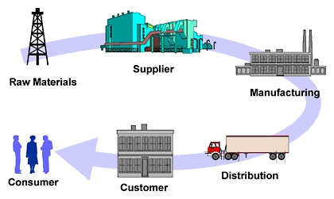
Supply Chain Management
What is Supply Chain Management?
Notes:
Supply chain management (SCM) is the management of the flow of goods. It includes the movement and storage of raw materials, Manufacturing the goods, and transporting the finished goods from point of origin to point of consumption.

Slide 10
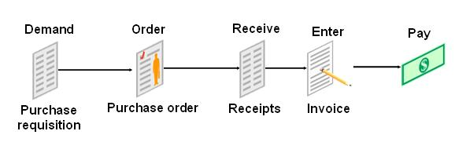
Procure To Pay

Slide 11
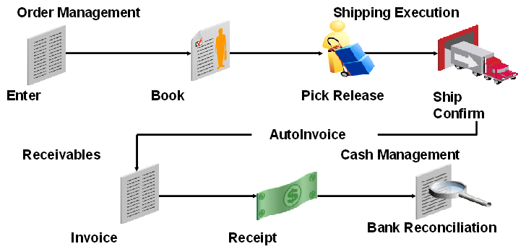
Order To Cash

Slide 12
Difference in SCM
We can customize the entire application in Oracle where as in SAP only some part can be customized.
Implementation cost is really high in SAP.
SAP takes more time of implement.
Depends on the company to either go for SAP or Oracle.

Slide 13
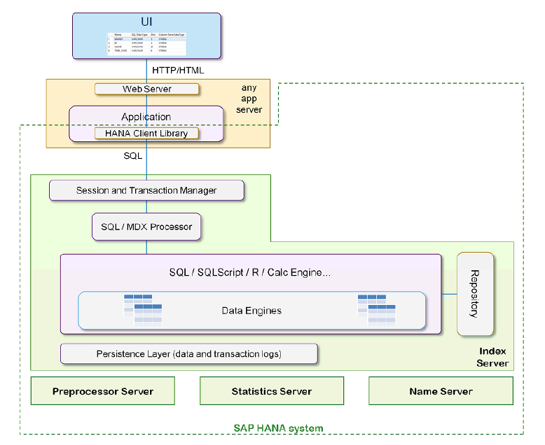
SAP HANA Database Architecture
Notes:
http://help.sap.com/hana/SAP_HANA_Developer_Guide_en.pdf

Slide 14
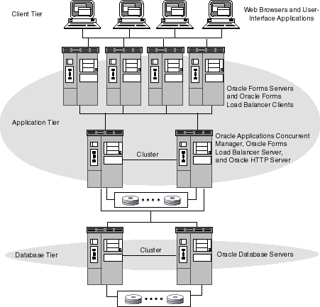
Oracle EBS Architecture
Notes:
http://docs.oracle.com/html/A95194_01/ofs_conc_man.htm
Oracle 12c Database supports oltp and Olap. Row and Column based.

Slide 15

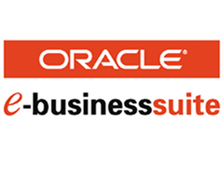
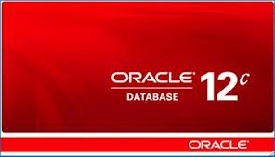
Oracle Application latest products
Fusion Applications
Oracle Enterprise Business Suite R12
Oracle 12C Database
Notes:
a combination of features and functionalities taken from Oracle EBS, JD Edwards, PeopleSoft and Siebel product lines.

Slide 16
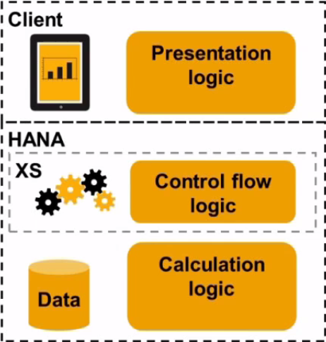
SAP Software latest products
SAP HANA

Slide 17
Customers Using SAP(CRM)
Name of the Customer | Type of Industry
Yaswaka International | Automation
McAfee | Software Security
Pacific Coast Feather | Home Textile
Premier foods | Food Manufacturing
PepsiCo | Beverages
Bloomberg | Financial software
Bentley Systems | Software Company
Lenovo | Electronics
T systems | IT & Consulting
Swissfox | Telecommunications
Pioneer Foods | Food Manufacturing
Asian Paints | Chemicals

Slide 18
Customers Using SAP(SCM)
Name of the Customer | Type of Industry
Linfox | Logistics
DeLaval | Dairy and Farming
DuPont | Chemicals
Radico Khaitan | Distillery
Sauer Danfoss | Hydraulics
Bharat Earth Movers | Heavy Equipment
Coca-Cola | Beverages
Groupe Hamelin | Consumer Goods
Schukat electronic | Electronics
Lexmark International | Software
Novus | Nutrition
Indigo Books & Music | Book seller

Slide 19
Customers Using Oracle Applications
Name of the Customer | Type of industry
Taconic | Rats Supplier
Tanishq | Diamond
Saudi Cement Company | Cement
Rochester Institute of Technology | College
LG Electronics | Electronics
McDonald's | Fast food Center
Hologic, Inc. | Medical devices
Emerson | Electric Company
Abu Dhabi Media Company | Media Company
Datacard Group | Identification Card
Korean Air | airline
IDBI Federal Life Insurance Company | Insurance Company

Slide 20
Customers Using Salesforce
Name of the Customer | Type of Industry
Activision | Game development
Burberry | Fashion house
Canon | Imaging Products
Dunkin Brands | Fast food restaurant
Electronic Arts | Game development
The Hershey’s | Chocolate
Thomson Reuters | Media and information based
Vodafone | Mobile
Yamaha | Bike Manufacturing
Japan Post | Logistics services
Carrier Builder | Job search site
Delta Airlines | Airlines

Slide 21
References
http://www.oracle.com/search/customers
http://www.sap.com/customer-testimonials/customers-a-z/index.epx#l
http://www.saphana.com/community/about-hana/features
http://docs.oracle.com/cd/B53825_08/current/acrobat/121ozfug.pdf
http://docs.oracle.com/cd/B15436_01/current/acrobat/ams115ug.pdf
http://docs.oracle.com/cd/A99488_01/acrobat/115ontug.pdf
http://docs.oracle.com/cd/B53825_08/current/acrobat/121asnug.pdf
http://docs.oracle.com/cd/A60725_05/pdf/csug.pdf
http://www.salesforce.com/products/

Slide 22
THANK YOU

